Slide 1
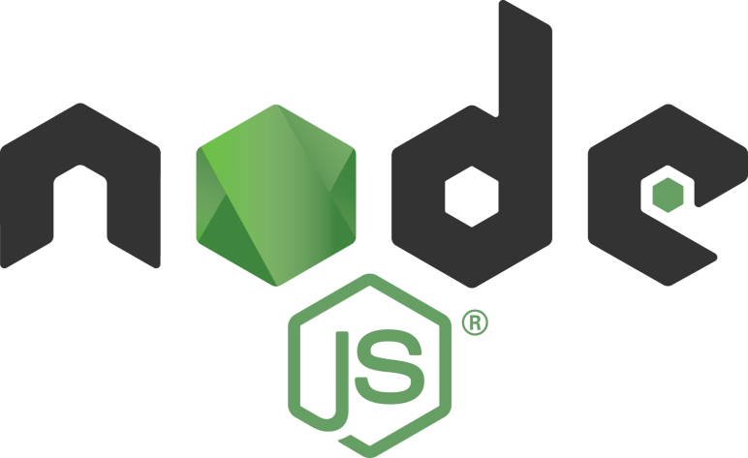

NodeJS & Heroku
Deploy NodeJS App to Heroku

Slide 2
Heroku is a container-based cloud Platform as a Service (PaaS). Developers use Heroku to deploy, manage, and scale modern apps. This platform is elegant, flexible, and easy to use, offering developers the simplest path to getting their apps to market.
First, you have to create account on heroku.com!

Slide 3
#1 Install Heroku CLI
Heroku Command Line Interface is built with Node.js and is installable via npm. Install Heroku CLI globally
$ npm install -g heroku-cli
Check Heroku CLI version
$ heroku --version
Login to Heroku (input email & password)
$ heroku login

Slide 4
#2 Prepare Our App
Clone NodeJS boilerplate that can be deployed to Heroku from my repo:
$ git clone https://github.com/LintangWisesa/Heroku_Deploy_Example.git
$ cd Heroku_Deploy_Example
You can edit app’s route on index.js! Run server locally, by default on port 5000.
$ npm install
$ node index

Slide 5
#3 Create Git Repo & Heroku Project
Create git repo locally then commit it:
$ git init
$ git add .
$ git commit –m "tes deploy heroku"
Create Heroku project:
$ heroku create
Creating app... done, ⬢ fierce-fjord-11487
https://fierce-fjord-11487.herokuapp.com/ | https://git.heroku.com/fierce-fjord-11487.git

Slide 6
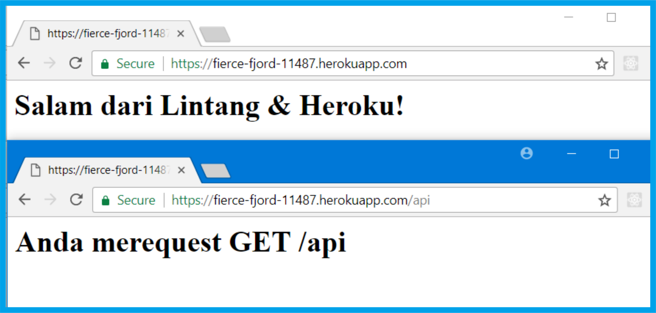
#4 Deploy
Deploy, then open our online app via browser!
$ git push https://git.heroku.com/fierce-fjord-11487.git
master

Slide 7
NodeJS & Heroku
Deploy NodeJS App to Heroku

